Slide 1


Galgotias
University
Home
About
Content
Others
SignUp
Web
Technology
Submitted By:
Prince Raj
Akhil Kumar Gupta 22SCSE1012996
Admission No.
22SCSE1011769
Submitted To:
M. Umapathy,
Assistant Professor

Slide 2
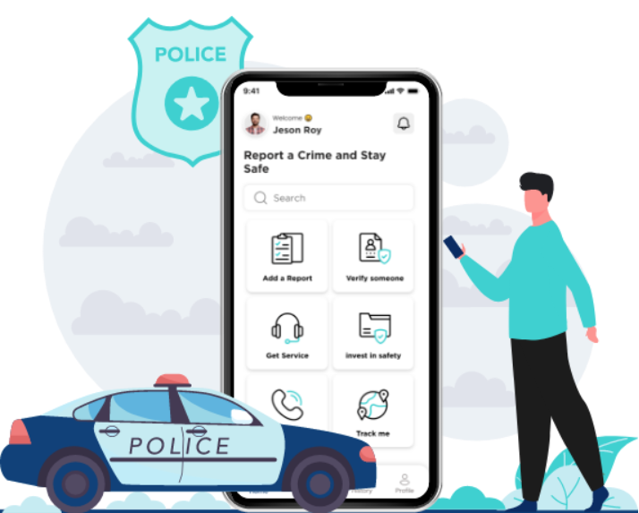
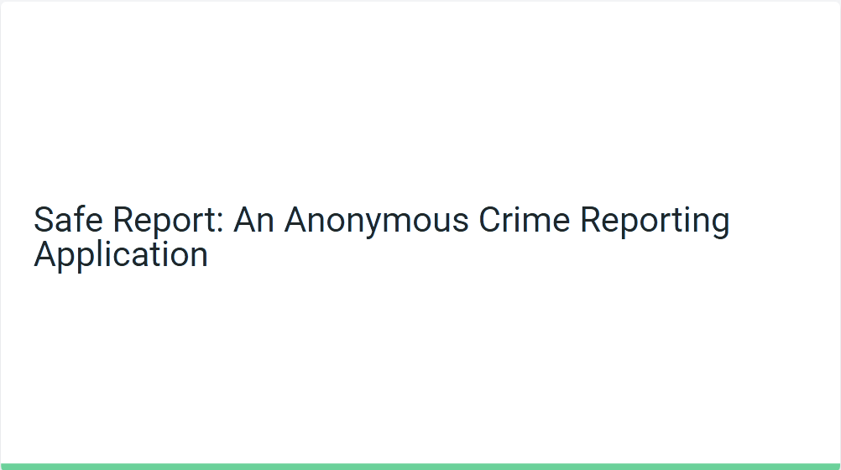
Safe Report: An Anonymous Crime Reporting Application

Slide 3
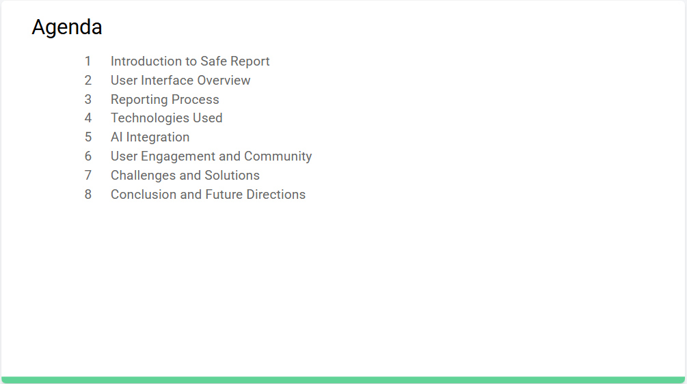


Slide 4
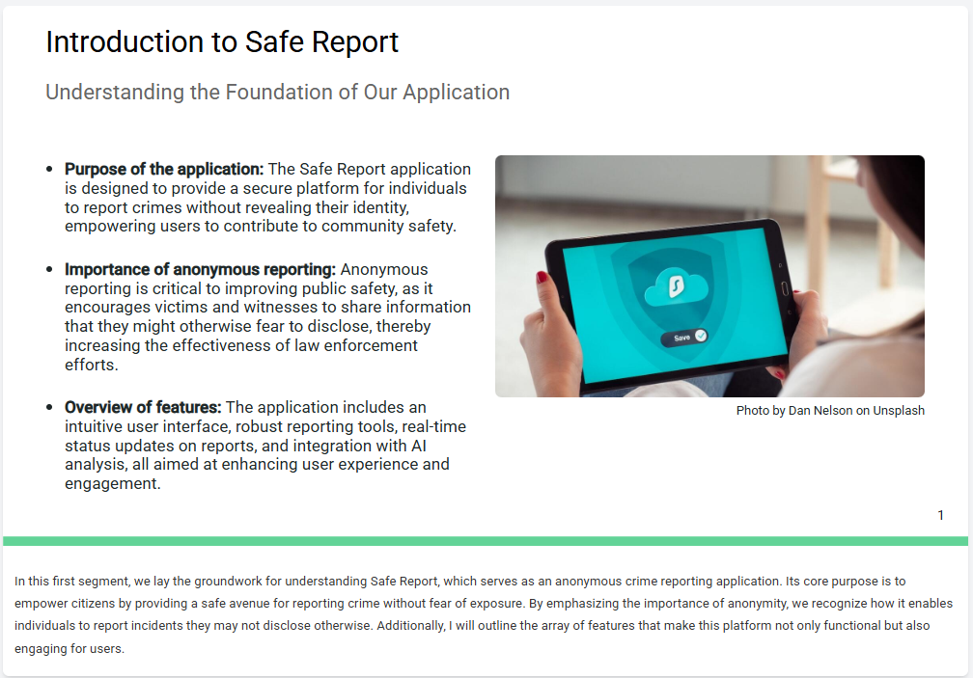


Slide 5
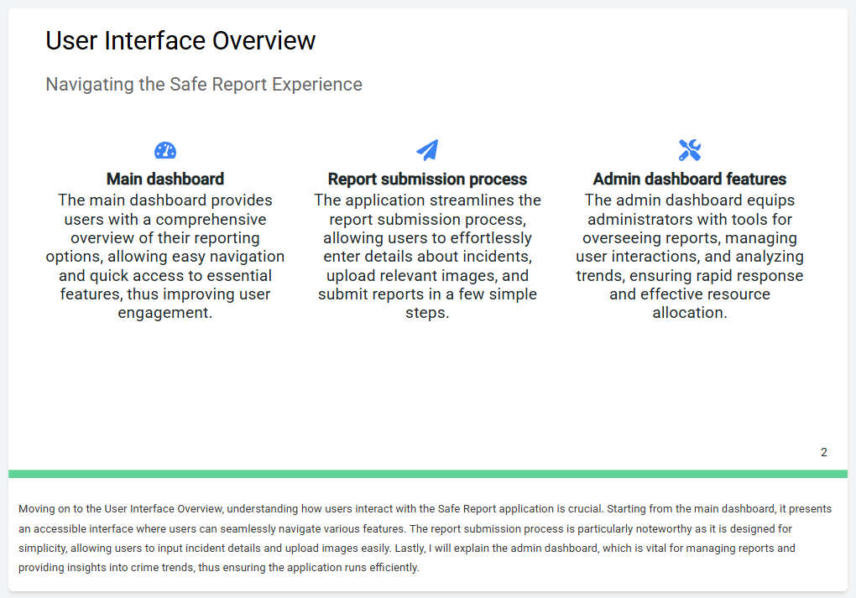

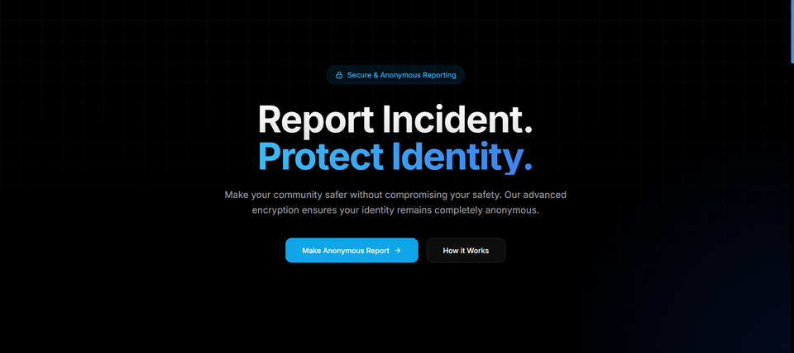

Slide 6
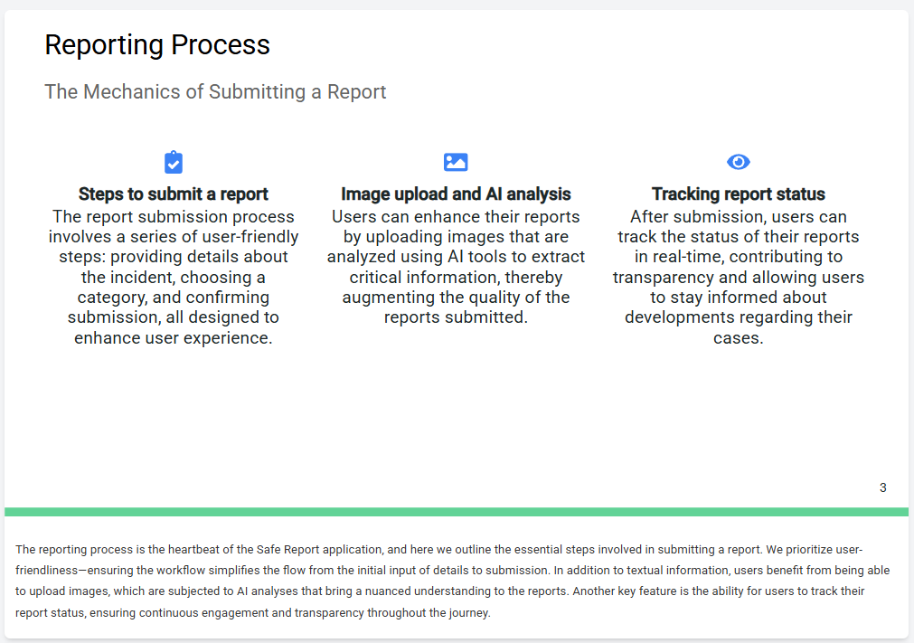


Slide 7
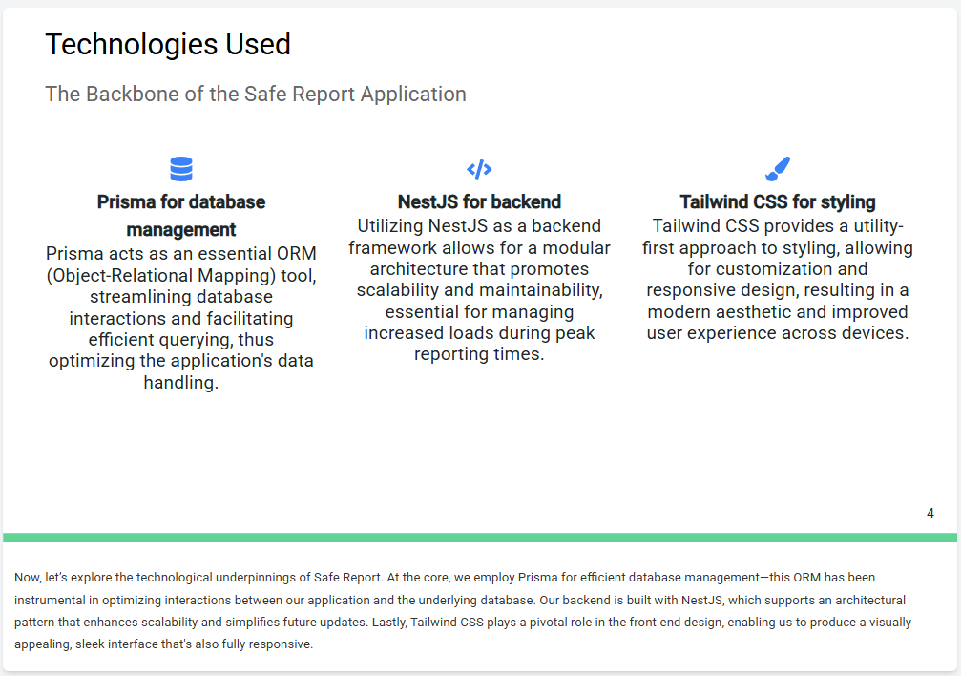

Slide 8
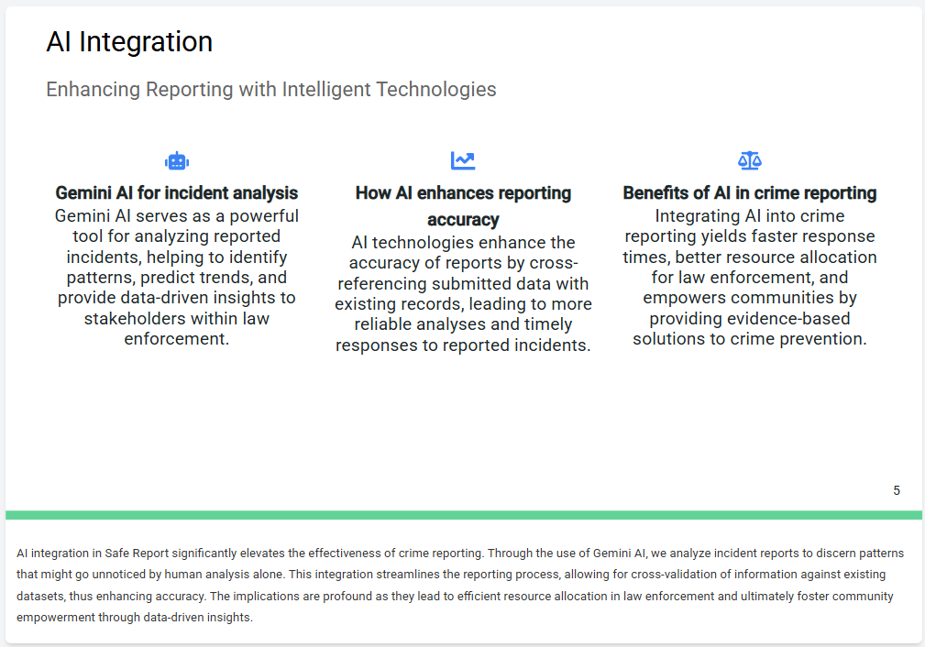



Slide 9
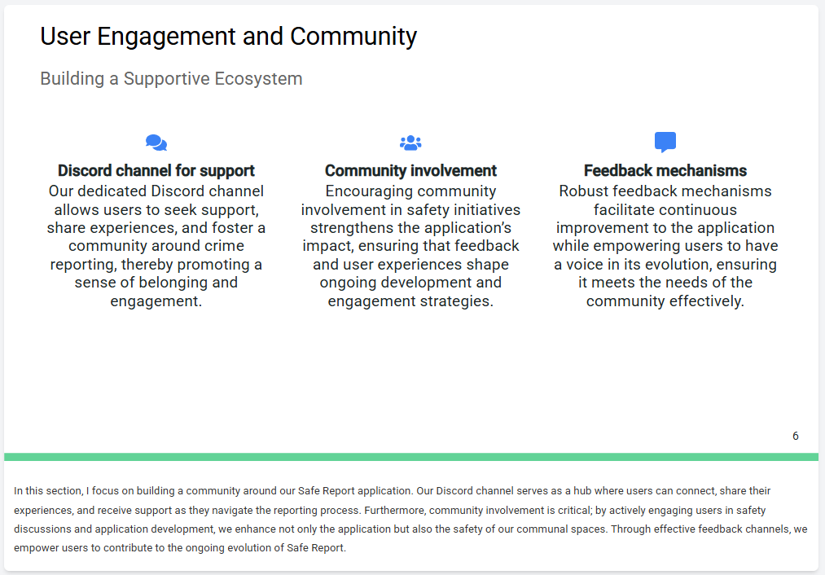


Slide 10
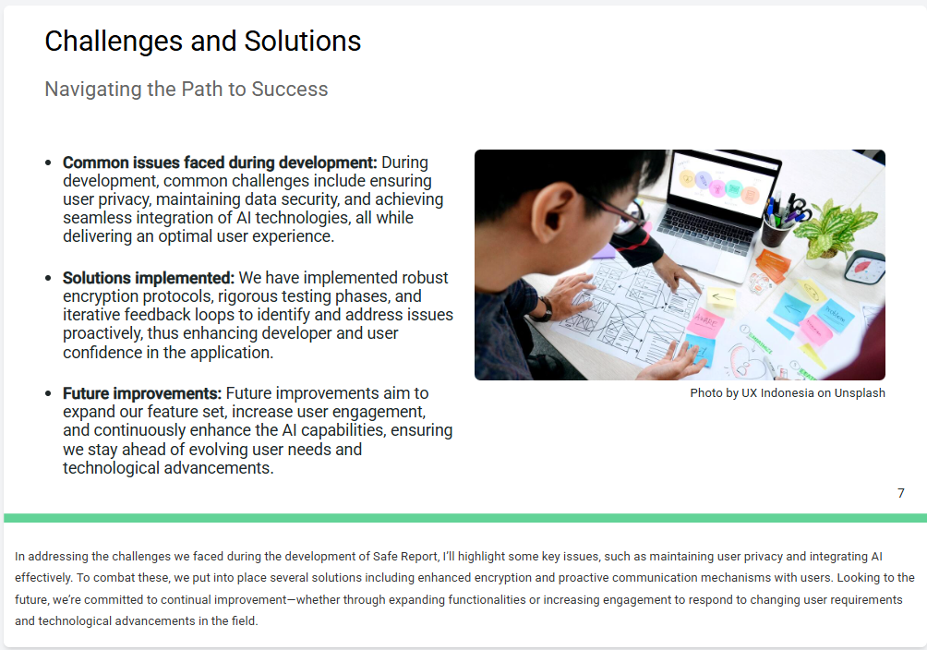


Slide 11
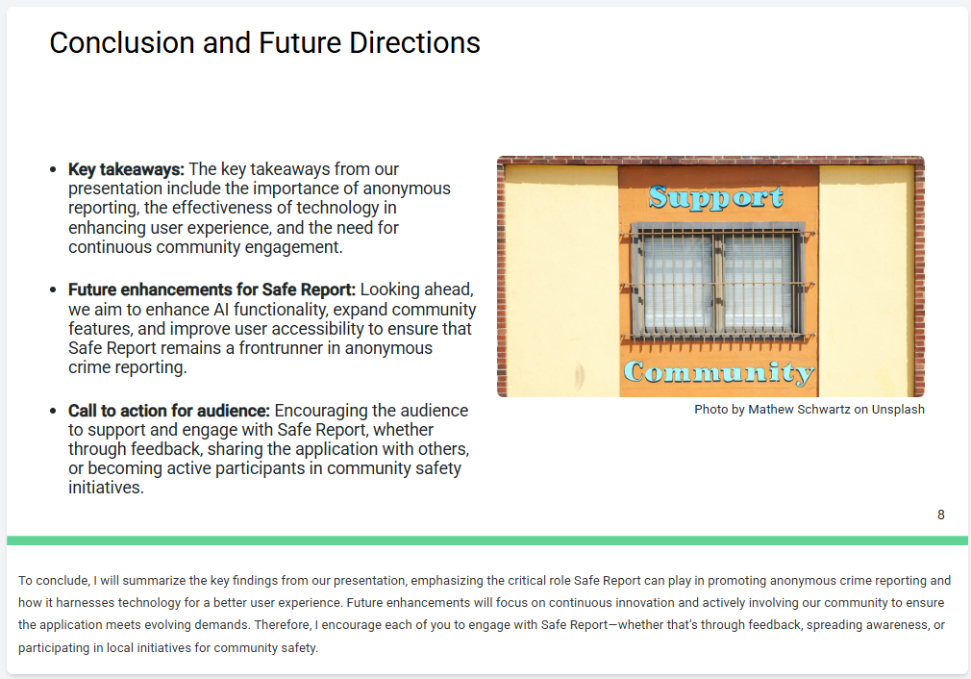

Slide 12
Thank You
I hope you found my presentation and the features of my projects insightful. Please do consider me for any relevant opportunities in the future.
Prince Raj | Akhil Km. Gupta
www.crime-report.com
-
praj821232@gmail.com

